Slide 1
ABOUT ME

Slide 2

PROPOSAL PROJECT Face Recognition with Attendance
-Raj Kumar Karki

Slide 3
TABLE OF CONTENTS
01
02
INTRODUCTION
WORKING MECHANISM
03
04
ALGORITHMS
LIMITATIONS

Slide 4

01 INTRODUCTION
A face recognition attendance system automatically identifies and confirms a person and records attendance based on their face detection.
It is very important in every work because it help to manage and make everything in a proper system.

Slide 5
01 INTRODUCTION
1.1
1.2
PROBLEMS
OBJECTIVES
1.3
METHODOLOGY

Slide 6
1.1
PROBLEMS
classical student attendance marking technique such as calling student names or checking respective identification cards.
There are not only disturbing the teaching process but also causes distraction for students during exam sessions.
Apart from calling names, attendance sheet is passed around the classroom during the lecture sessions.
A large number of students might find it difficult to have the attendance sheet being passed around the class.

Slide 7
1.2
OBJECTIVES
The objective of this project is to develop face recognition based automated student attendance system.
To classify the features in order to recognize the face detected.
To record the attendance of the identified student.
To identify the student faces accurately.
To mark the attendance automatically.
To reduce the time and the efforts required for manual attendance.

Slide 8
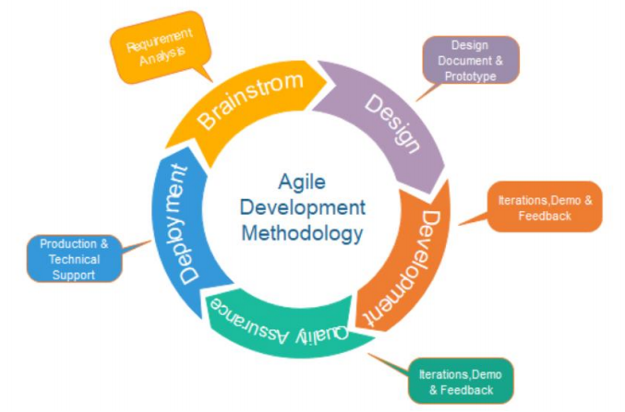
1.3 METHODOLOGY
In my project I have used Agile methods for the development process which is easy to used and saves many times.
Every errors can be maintain at the moments.

Slide 9
AGILE METHODOLOGY
Following are the phases in the Agile model are as follows:
Requirements gathering
Design the requirements
Construction/ iteration
Testing
Deployment
Feedback

Slide 10
02 WORKING MECHANISM
The working mechanism behind a Face Recognition Attendance System is based on the use of facial biometric data to recognize individuals. Typically this process can be divided into four stages:
Dataset Creation
Face Detection
Face Recognition
Attendance Upgradation

Slide 11
02 WORKING MECHANISM
2.1
2.2
DATASET CREATION
FACE DETECTION
2.3
2.4
ATTENDANCE UPGRADATION
FACE RECONGITION

Slide 12
2.1
DATASET CREATION
Images of students are captured using a web cam.
Multiple images of single student will be acquired with varied gestures and angles.
Images will be converted from RGB to gray scale images.
Images will be saved as the names of respective student in a folder.

Slide 13
2.2
FACE DETECTION
Face detection here is performed using Haar-Cascade Classifier with OpenCV.
Haar Cascade algorithm needs to be trained to detect human faces before it can be used for face detection.
This is called feature extraction.

Slide 14
2.3
FACE RECONGITION
recognition process histogram of the face to be recognized is calculated and then compared with the already computed histograms and returns the best matched label associated with the student it belongs to

Slide 15
ATTENDANCE UPGRADATION
2.4
After face recognition process, the recognized faces will be marked as present in the attendance sheet and the rest will be marked as absent .

Slide 16
03 ALGORITHM
Capture the student’s image through camera.
Detect each and every individual face by apply face detection algorithm.
Extract the ROI(Region Of Interest) in rectangular bounding box.
Converting to gray scale, apply histogram equalization and resize to 100x 100 i.e. apply pre-processing.
If image captured then Store in database Else Apply LBPH (for feature extraction ) Apply SVM( for classification) End if
6. Post-processing

Slide 17
Local Binary Patterns Histogram(LBPH) Step- by -step algorithm:
1. Parameters: the LBPH uses 4 parameters:
1. Radius:
the radius is used to build the circular local binary pattern and represents the radius around the central pixel. It is usually set to 1.
2. Neighbours: the number of sample points to build the circular local binary pattern. Keep in mind: the more sample points you include, the higher the computational cost. It is usually set to 8.
3. Grid X: the number of cells in the horizontal direction. The additional cells, the finer the grid, the higher the dimensionality of the resulting feature vector. It is usually set to 8.
4. Grid Y: the number of cells in the vertical direction. The more cells, the finer the grid, the higher the dimensionality of the resulting feature vector.

Slide 18
Training the Algorithm:
First, we need to train the algorithm. To do so, we need to use a dataset with the facial images of the people we want to recognize. We need to also set an ID (it may be a number or the name of the person) for each image, so the algorithm will use this information to recognize an input image and give you an output. Images of the same person must have the same ID.
Applying the LBP operation:
The first computational step of the LBPH is to create a intermediate image that describes the original image in a better way, by highlighting the facial characteristics. To do so, the algorithm uses a concept of a sliding window, based on the parameter’s radius and neighbours.
Extracting the Histograms:
Now, using the image generated in the last step, we can use the Grid X and Grid Y parameters to divide the image into multiple grids.

Slide 19
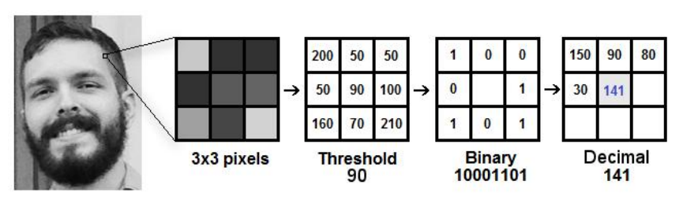
LBPH Algorithm

Slide 20
04 LIMITATIONS
It can’t detect faces without frontal view and upright orientation

Slide 21
Expected Outcome
This system aims to build an effective class attendance system using face recognition techniques. The proposed system will be able to mark the attendance via face Id. It will detect faces via webcam and then recognize the faces. After recognition, it will mark the attendance of the recognized student and update the attendance record.
We have developed a system that automatically detects and recognizes students' faces and displays their information and whether he was registered or not. This would be possible by applying deep learning and image analysis algorithms to detect student's faces.

Slide 22
THANK YOU
Do you have any questions?
Feel free to ask

